Slide 1
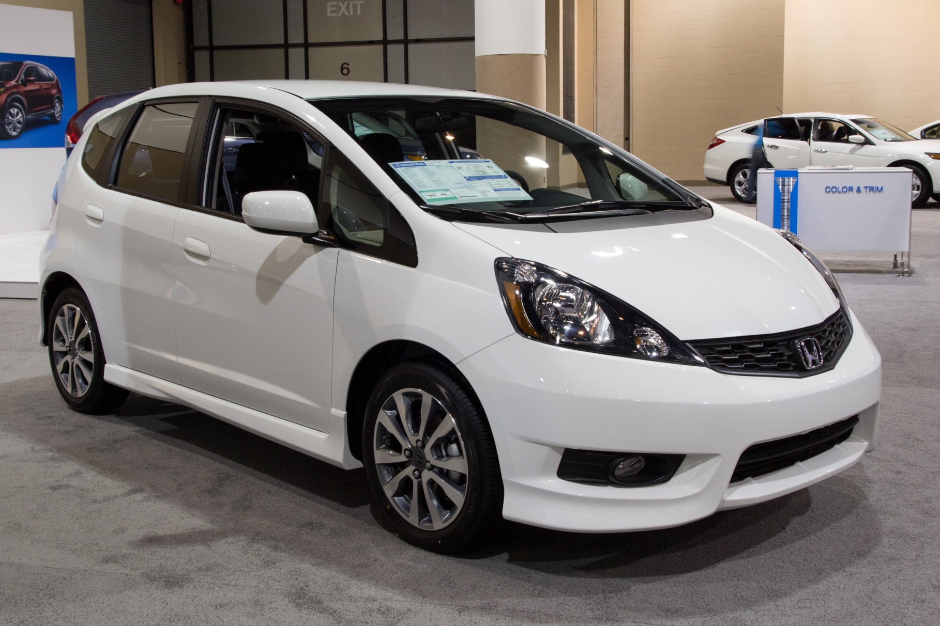
© M R / Shutterstock.com
Price: $20,000
Notes:
Source: www.caradvice.com.au

Slide 2
Lenders
Financial Institution | Term of Loan | Interest Rate
Midtown Bank | $20,000 48 months | 4.0%
Century Credit Union | $20,000 48 months | 2.0%
YourCharge Credit Card | $20,000 48 months | 18.0%
Al’s Car Emporium | $20,000 48 months | 8.0%
Notes:
It would be nice to have icons for the banks.

Slide 3
Lenders
Financial Institution | Term of Loan | Monthly Payment
Midtown Bank | $20,000 48 months | $451.58
Century Credit Union | $20,000 48 months | $433.90
YourCharge Credit Card | $20,000 48 months | $587.50
Al’s Car Emporium | $20,000 48 months | $488.26

Slide 4
Lenders
Financial Institution | Term of Loan | Total Cost of Car
Midtown Bank | $20,000 48 months | $21,675.84
Century Credit Union | $20,000 48 months | $20,827.20
YourCharge Credit Card | $20,000 48 months | $28,200.00
Al’s Car Emporium | $20,000 48 months | $23,436.48

Slide 5
Interest Rate
The price paid for using someone else's money, expressed as a percentage of the amount borrowed (usually expressed as an annual rate).

Slide 6
Savings Opportunities
Financial Institution | Type of Savings | Interest Rate
Midtown Bank | Passbook account | 1.0%
Century Credit Union | Passbook account | 0.25%
Johnson Bank | 5-year CD | 4.0%
Top End Brokerage | 10-year CD | 5.0%

Slide 7
Savings Opportunities
Financial Institution | Type of Savings | Total Savings in 10 Years
Midtown Bank | Passbook account | $11,051
Century Credit Union | Passbook account | $10,253
Johnson Bank | 5-year CD | $14,908
Top End Brokerage | 10-year CD | $16,470

Slide 8
The Market for Loans: Supply
Interest rate
(Price)
As we noted earlier, savers will shop around for a higher interest rate. An interest rate of 4% will bring a lot more savers into this market.
Supply
7%
6%
Very few individuals are willing to save or lend their money at a low interest rate. No one is willing to save at 0 or 1% in this market.
5%
An interest rate of 6% draws even more savers into the market. They can accumulate a lot more money in a shorter period of time.
4%
3%
2%
1%
0%
100
200
300
400
500
Quantity

Slide 9
The Market for Loans: Demand
Interest rate
(Price)
7%
A lower interest rate draws more borrowers into the market. You would much rather buy a car at 4% than 6%.
6%
5%
The lower the interest rate is, the more borrowers decide now is the time to buy a car or house.
4%
Borrowers aren‘t very likely to demand money at high interest rates, because they know it will be more expensive to pay back the loan.
3%
2%
1%
Demand
0%
100
200
300
400
500
Quantity

Slide 10
The Market for Loans
Interest rate
Supply of loans
Equilibrium interest rate
Demand for loans
Equilibrium quantity
Quantity of loans
Notes:
Numbers on the graph will depend on the design of the interactive game. If this is like the Market for Oil game, the graph will be created to use the data from the cards.

Slide 11
The Market for Loans
What will happen in the market for loans if more people want to borrow at the same time?
Interest rate
Supply of loans
Equilibrium interest rate
Demand for loans
Equilibrium quantity
Quantity of loans

Slide 12
The Market for Loans
What will happen in the market for loans if lenders think more borrowers than normal may not repay their loans?
Interest rate
Supply of loans
Equilibrium interest rate
Demand for loans
Equilibrium quantity
Quantity of loans

Slide 13
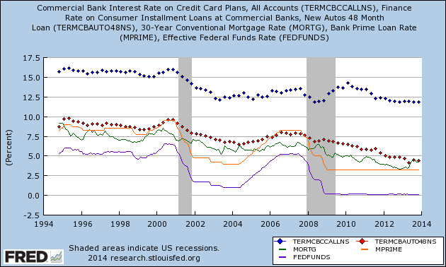
Which interest rate are we talking about?
Notes:
I couldn’t find student loan rates on FRED, but they should be included.

Slide 14
Selected Interest Rates
Federal funds rate — The rate one bank charges another for an overnight loan
Prime rate — The rate banks charge their best customers
30-year fixed mortgage rate — The rate banks charge homebuyers seeking fixed, long-term loans
Automobile loan rate — The rate banks charge for loans used to buy automobiles
Credit card rate — The rate credit card companies charge those who use their cards for purchases

Slide 15

Interest rates are linked.
?
Credit card rate
?
Automobile loan rate
?
30-year mortgage
?
Prime rate
Federal funds rate
Notes:
Image source: wikipedia (This would probably work better if we just took a picture of a hand)

Slide 16
Factors That Affect Interest Rates
Loan size
Maturity (length of time)
Risk
Collateral

Slide 17
Midtown Bank
Maggie – 4%
Juan – 8%
Sam – 12%
Notes:
I’d like to have images or avatars for these three people.

Slide 18
Who Will You Lend To?
What questions will you ask prospective customers?

Slide 19
Who Will You Lend To?
Suggested questions:
How much money do you want to borrow?
For what purpose? Will there be collateral?
What is the length of the loan?
Do you have a job?
How much do you earn?
What other loans are you still repaying?
Have you ever defaulted on a loan?

Slide 20
Potential Borrowers
James Shen
Amanda Sykes
Diana Starr
Michael O’Neill
Trevor Johnson

Slide 21
Interest Rates and Inflation
If Midtown Bank expects inflation to be 3% over the next few years, it will add 3% to the interest rate it was already charging.
Midtown Bank wants to earn 3%“real” interest on a loan, so it charges a loan customer:
3% interest + 3% inflation premium = 6%

Slide 22
Interest Rates are Linked
Credit card rate
Automobile loan rate
30-year mortgage
Prime rate
Federal funds rate
Notes:
22
Image source: wikipedia (This would probably work better if we just took a picture of a hand)

Slide 23
Nominal Versus Real Interest Rates
The interest rates discussed at the beginning of the lesson—car loans, mortgages, and credit cards—are all nominal rates. That means they include charges for expected inflation.
To calculate real interest rates, economists subtract the inflation rate from nominal rates.

